Slide 1


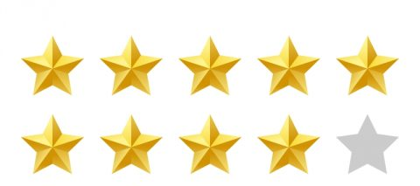
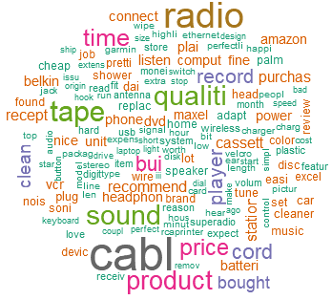
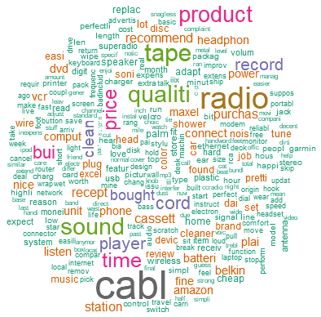
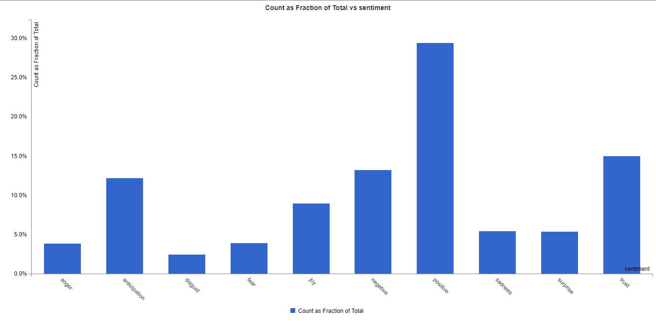
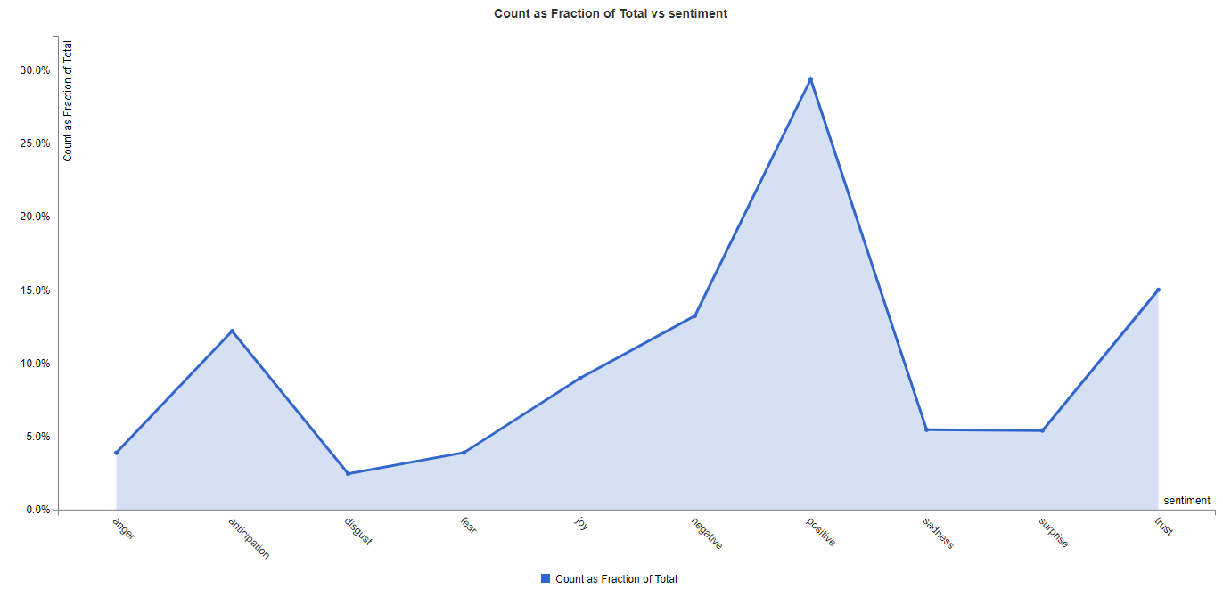
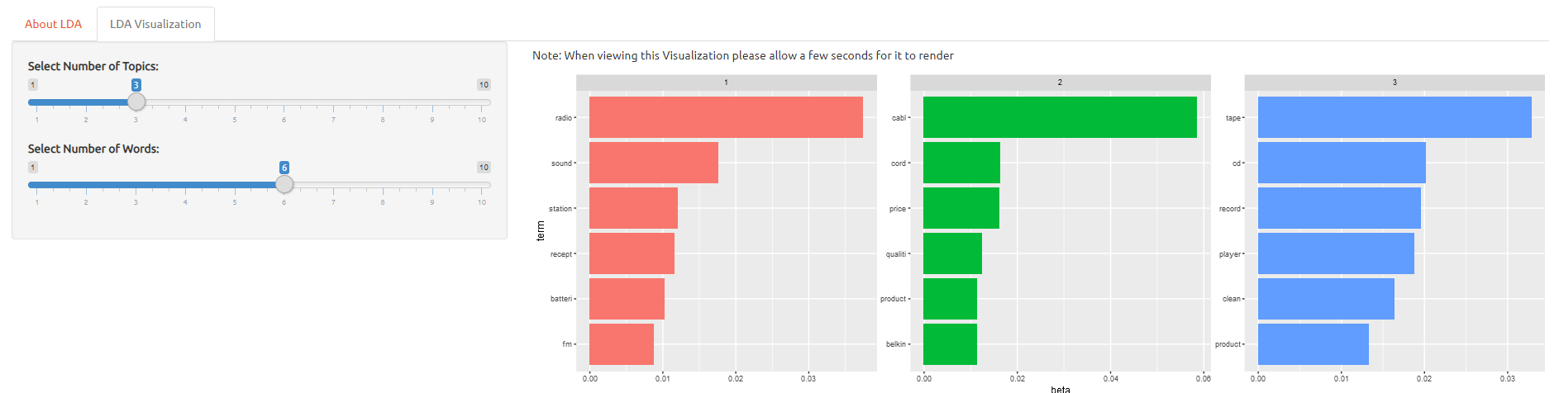
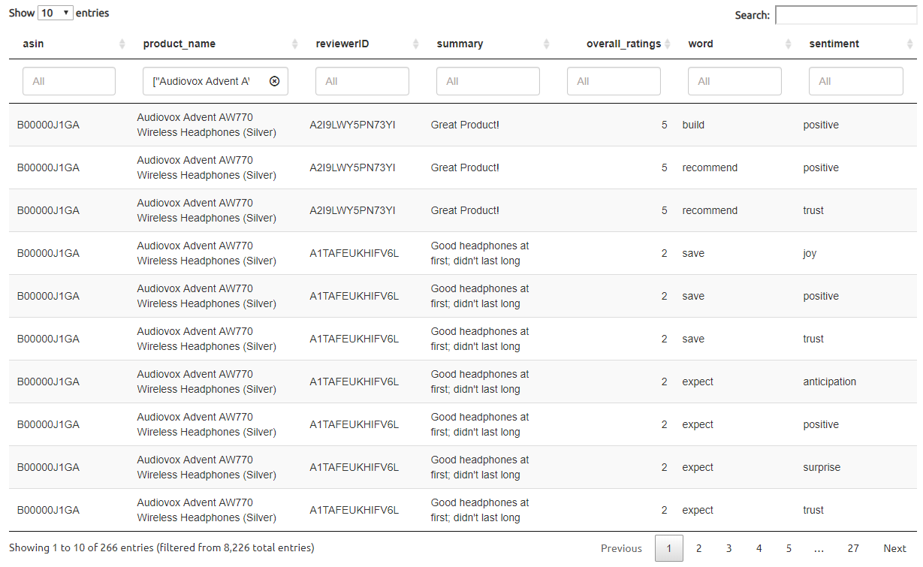
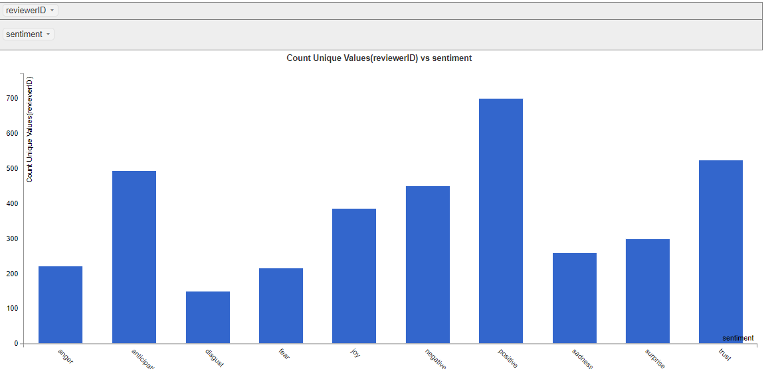
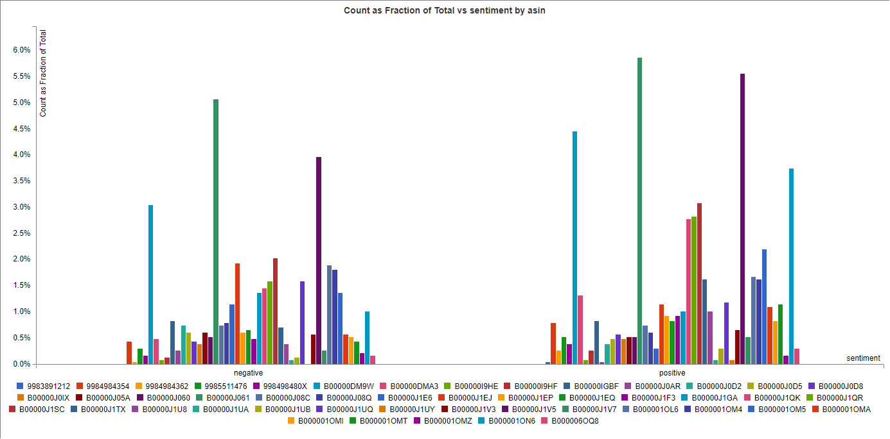
Identification of Constructive Sentiment from Potentially Biased Reviewer Remarks
Team 16 ATL Go Jackets
Priya Sampathkumar
psampathkumar3@gatech.edu
April Draper
aprildraper@gatech.edu
Divya Paduvalli
dpaduvalli3@gatech.edu
Jake Rocker
jacob.rocker@gatech.edu
Introduction
Is a review really honest? How can you tell if a reviewer has a potential bias? Consumers rely on reviews to give them an idea of the potential benefits or drawbacks of a product. Consumers should be able to verify the potential bias of an online review so purchase decisions can be made without regret.
Data
We have decided to use a downloaded, static electronics product reviews dataset compiled by Julian McCauley of UCSD and Stanford University. This dataset has over a million reviews and is around 1.5 gigabytes in size when converted to csv. It covers a diverse range of electronics offered from different manufacturers and related information that will be helpful in our analysis.
Approach
We used R and Shiny to write suitable algorithms to mine the text reviews and identify positive/negative sentiments and create our web application. We group the analysis and present it to the user to identify potentially biased reviewers and allow users to evaluate the validity of a review by revealing the potential bias, as well as, identifying products that negatively biased reviewers are more likely to review and those that positively biased reviewers frequently review. Linking potentially biased reviewers to products is new and could help users identify the validity of the review. Giving users a word cloud will help them visualize the review, allowing them to observe common themes that reflect positive/negative emotions quickly.
Users have the option to select the number of words and the frequency of use of words in their wordcloud.
Users have the option to select from different graphs to help them visualize the sentiment of the review.
Evaluation & Results
To measure the accuracy of our model, we split ~70% of our data for training and ~30% for testing. We used the training set to fit and tune our model and a testing set to evaluate model accuracy. The model was adjusted to present the reviewer’s bias, if present, as well as the sentiment analysis for reviews. The user interface was designed to allow users the freedom to view the results in different ways to aide in gaining an overall understanding of the sentiment and bias of the review and reviewer. This method is different from others because it allows the user to come to a solid conclusion of the validity of the review after viewing and reviewing the many charts and graphs. We had family and friends test our web application and received very positive feedback.
Users can visualize the most frequently used words by topic.
Users can view the reviews of all products at once, or select individual products to more easily analyze and understand the reviews and reviewers.
Users can select a product to view the review summaries with the sentiment expressed. This helps users understand whether it is overall positive or negative.
Users can view the overall sentiment of a particular reviewer by id and obtain a sense of reviewer bias.

